Slide 1
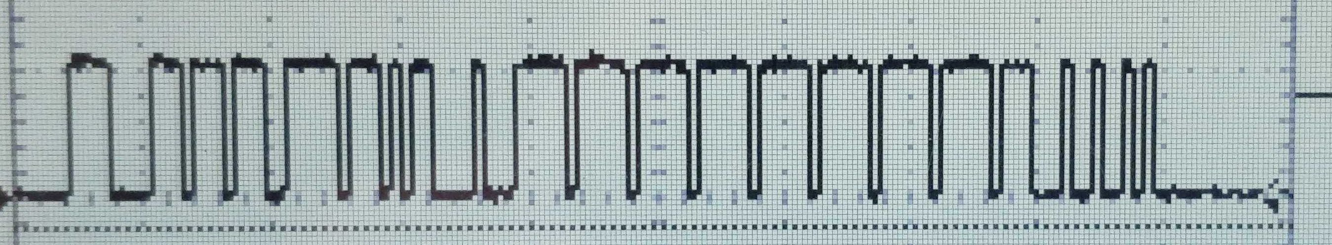
0b11
Bit stuff 1
five 0’s and bit stuff 1 repeats
0
0000 with a bit stuff 1
00000
101
0111
This is where the message seems to stop
000
001111
0000 with a bit stuff 1

